Slide 1
Recap
SRF, DDSRF, DSOGI, MCCF, Discrete SRF were implemented in Simulink
Intuitive applet – plots and comparisons between schemes
Presently used design
The design of the loop filter (k_{p} and k_{i}) used in all the schemes were taken as is, from literature
Intention was to match the results with those in the literature
All schemes rely on the Wiener optimization method
A good trade-off between filtering characteristic and dynamic response
Motivation for our design
Filtering aspect of the PLL is taken care of by the modifications as seen in DDSRF, DSOGI, MCCF etc.
e.g. in MCCF
Result: decoupling of filtering characteristic and dynamic performance
done by additional stages
can be separately focused on

Slide 2
A novel design optimization method
Error quantization
Newton
Raphson
ω_{n}
δ
Self-consistent equations
Damping optimization
Cardan’s
Analytical
Solution

Slide 3
How does it work?
Gives a single (k_{p} , k_{i}) pair for a given grid condition, pertaining to user specifications
Variables (grid situation + user specification) are:
Frequency excursion
Phase jump
Error band
Settling time
Demo
Advantages
Existing methods involve trial and error as infinitely many (k_{p} , k_{i}) pairs may arise for a particular situation
Both error and damping is optimized
3D lookup table - can be loaded on the DSP/microcontroller
Depending on a set of grid situation at any time instant, the optimized values can be picked
Theoretical inferences can be made for educational purposes
Hardware implementation
Work has been started on the MSP430 Launchpad with basic testing and debugging of the ADC and PWM modules

Slide 4
Thank you

Slide 5
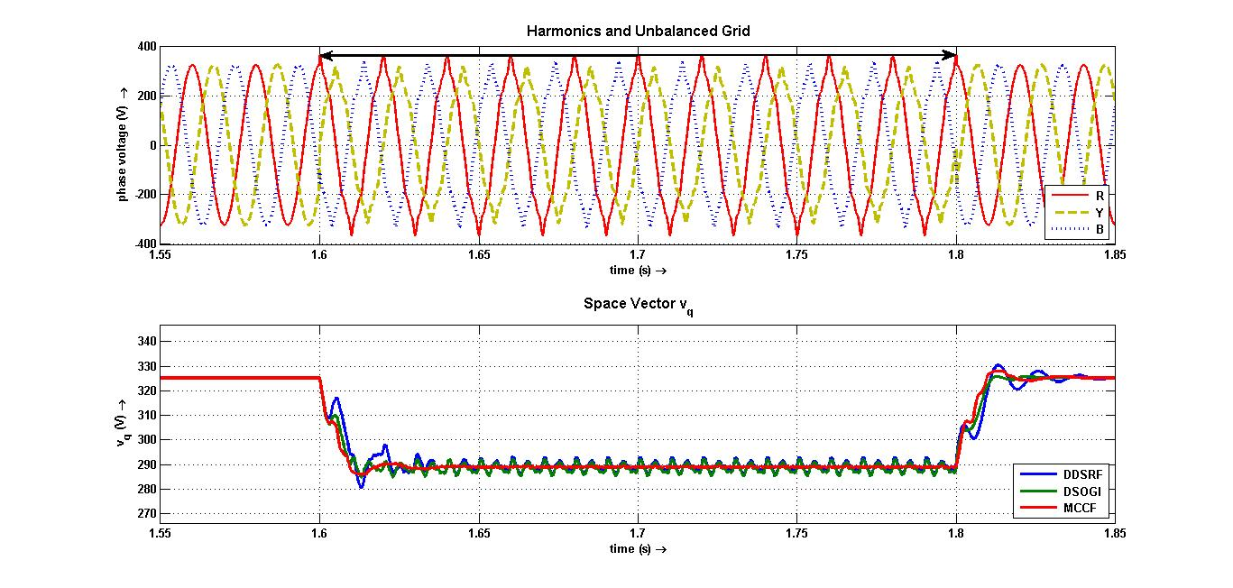
DDSRF, DSOGI, MCCF on Harmonics + Unbalanced Grid
Back

Slide 6
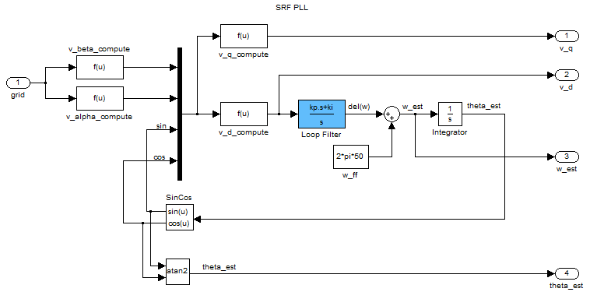
Conventional SRF PLL
Back

Slide 7
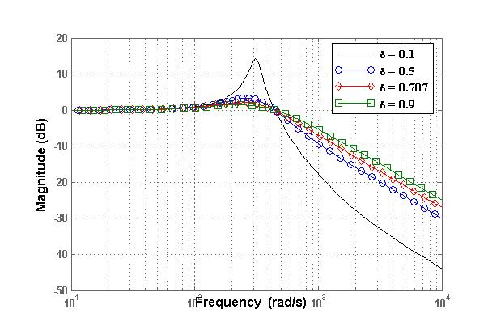
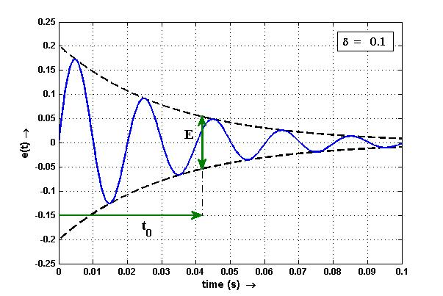
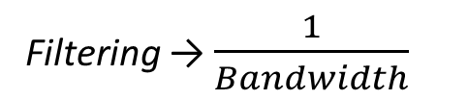
Filtering characteristic v/s Dynamic response
Back
Filtering → $\frac{1}{Bandwidth}$
Dynamic performance → Bandwidth
Wiener method: a good trade-off between filtering and dynamic response

Slide 8
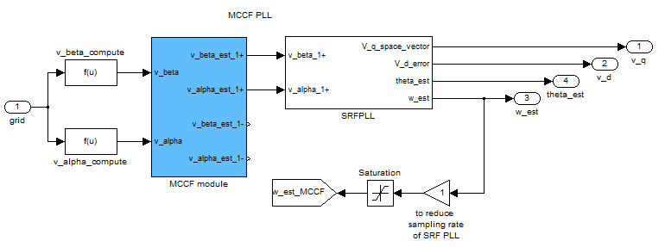
MCCF - PLL
Back

Slide 9
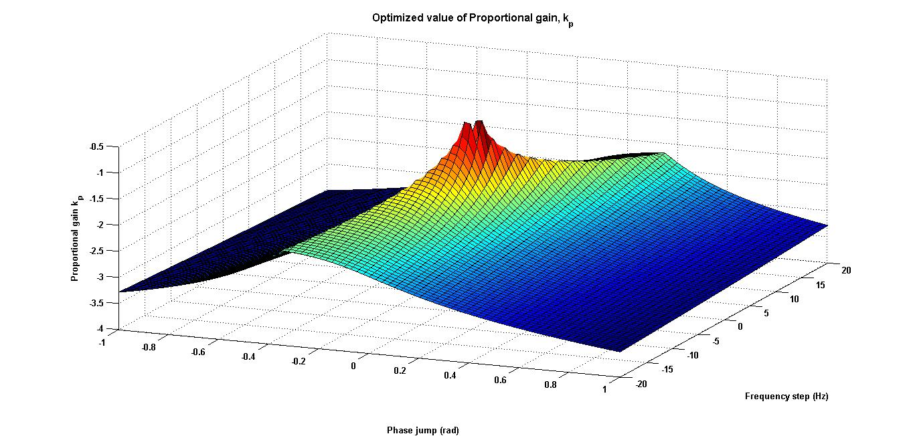
3D lookup table - k_{p}

Slide 10
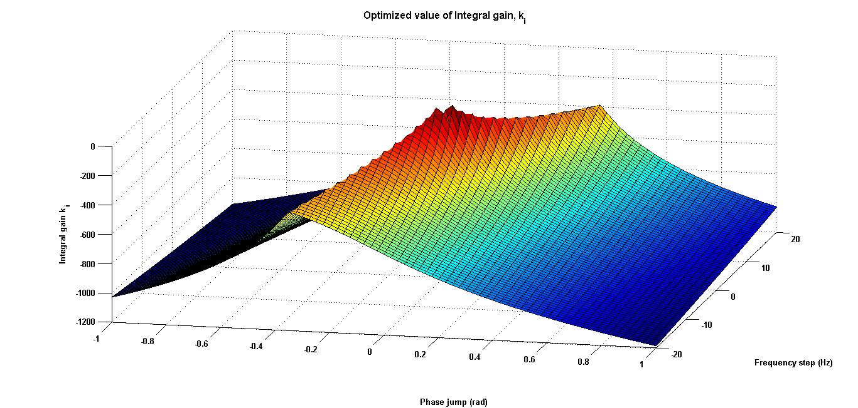
3D lookup table - k_{i}

Slide 11
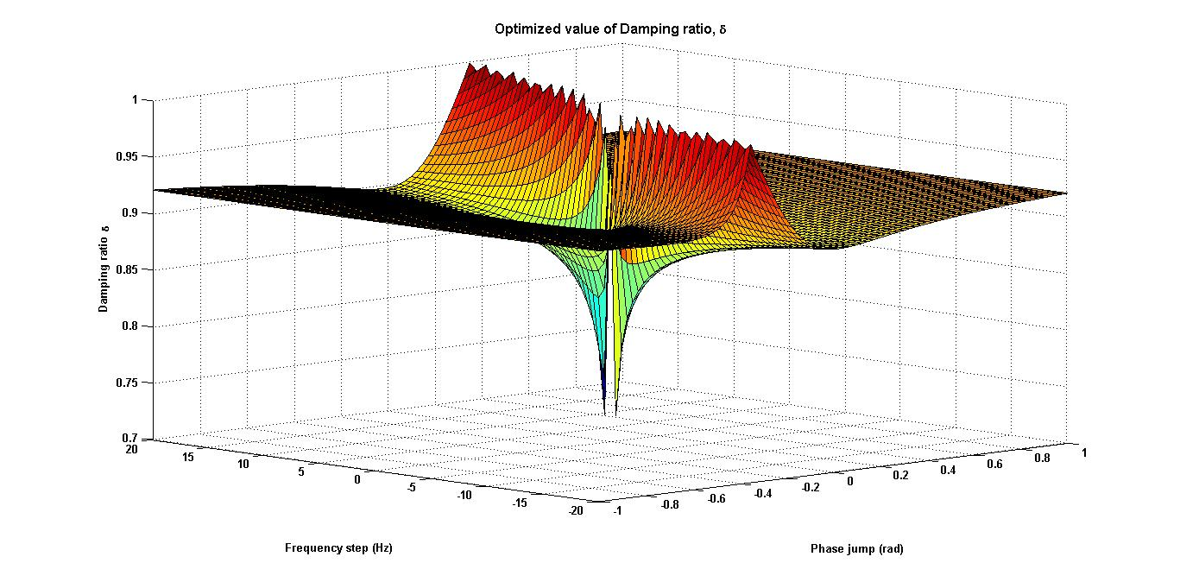
3D lookup table – damping ratio

Slide 12
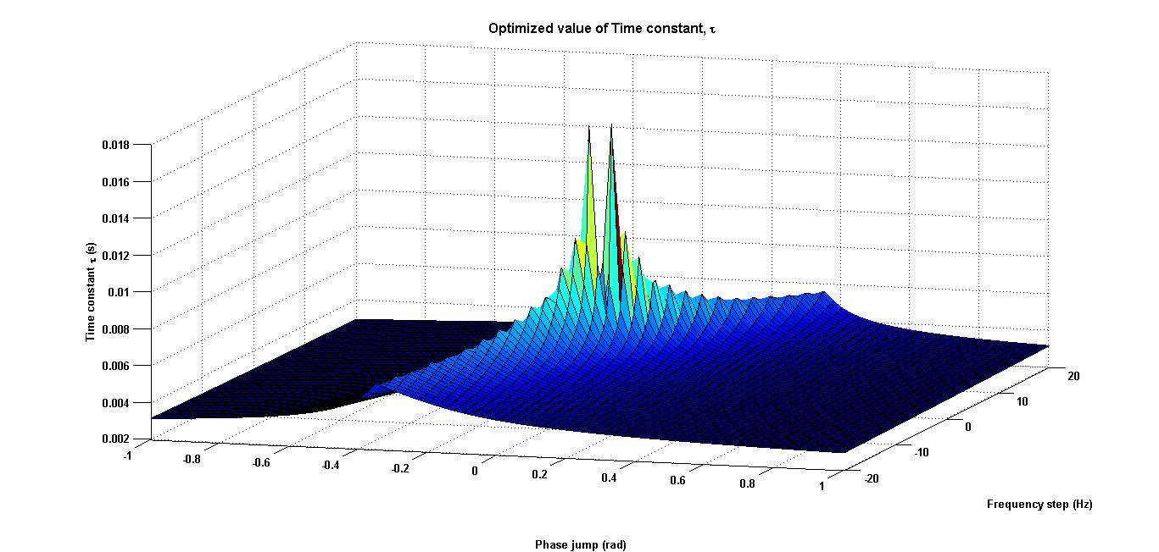
3D lookup table – time constant

Slide 13
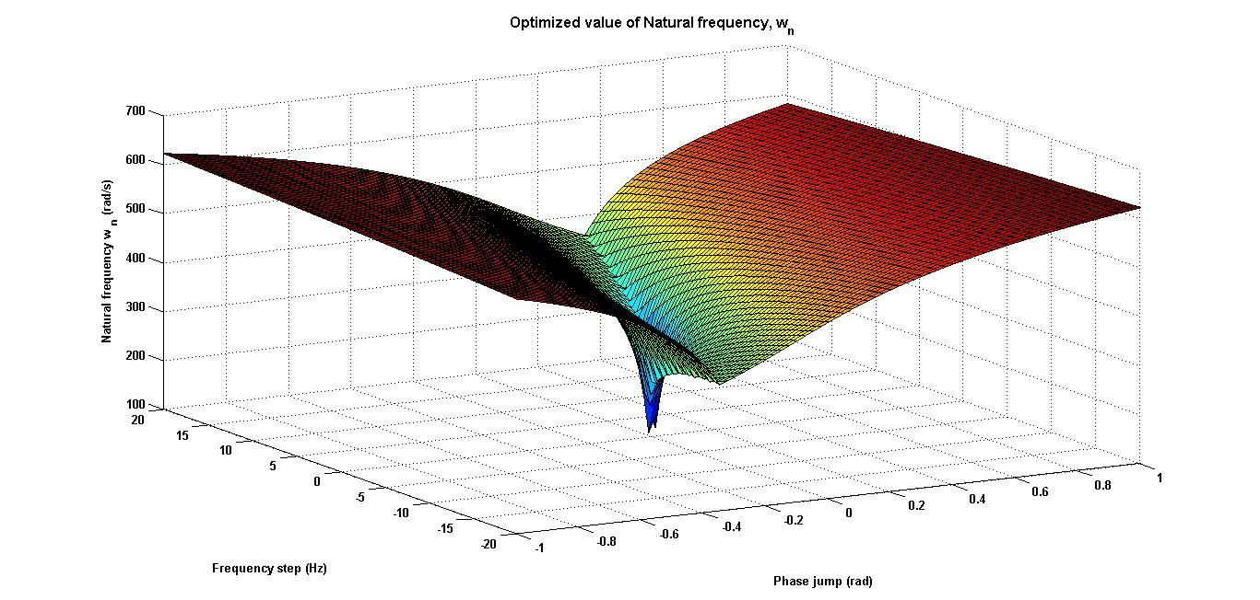
3D lookup table - w_{n}
Back

Slide 14
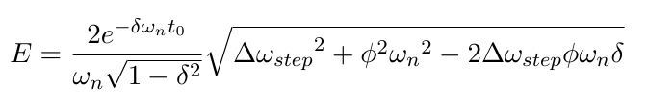
Error quantization
Back

Slide 15
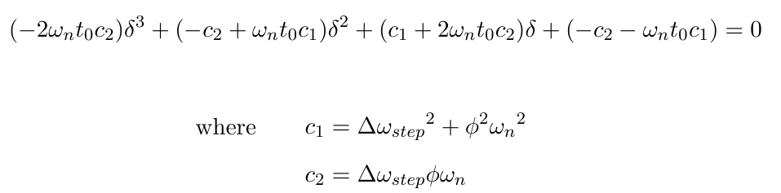
Damping optimization
Back

Slide 16
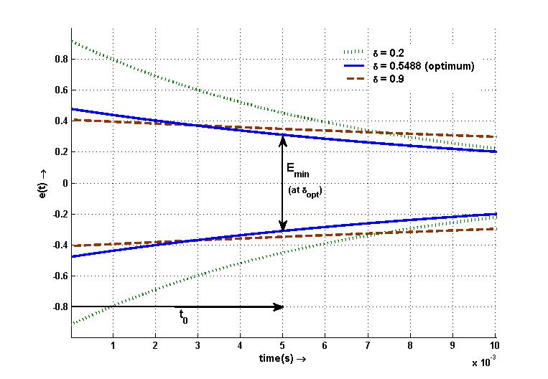
Damping optimization - comparisons
Back

